Slide 1



Confidential | Deck 2025
EVERYTHING AND EVERYONE ALWAYS INLINE!
Smart Hub maximizes everyone’s connection to everything with no interference to any of your existing systems or processes!
Presentation

Slide 2






EVERYTHING AND EVERYONE ALWAYS INLINE!
Secure
Presentation
Deck 2025
No interference with any of your existing systems or processes!

Slide 3



YOU MANAGE YOUR HOME USING A SMART HUB
WHY NOT YOUR COMMUNITY?
PAGE NO 01
Welcome to our Universal Smart Hub Platform!
SMART HUB
SMART LINKS
MOBILE APP
Receives input and maximizes everyone’s connection to everything through Smart Links and Mobile App.
Insert in email and social to avoid long scrolls and maximize the power of all messaging.
Maximizes everyone’s connection to all Smart Hub Communications.
Replaces phone calls and email as everyone’s initial point of contact for nearly everything.

Slide 4
PAGE NO 02
RESPONSIVENESS
Smart Hub provides everyone with instant access to nearly everything through Mobile App.
EVERYTHING AND EVERYONE ALWAYS CONNECTED
EVERYTHING AND
EVERYONE ALWAYS
INLINE!
MESSAGING
Mobile App Inbox lists the latest news and events in order of priority.
Smart Links inserted in Email and Social eliminate scrolls and maximize the power of all your sends and posts.
THIRD PARTY SYSTEMS
Community enjoys instant access to all 3rd Party systems.
Visitors enjoy instant access to your marketing website.
ONE INLINE PLACE delivers the seamless, all-in-one experience residents will love and you deserve!

Slide 5
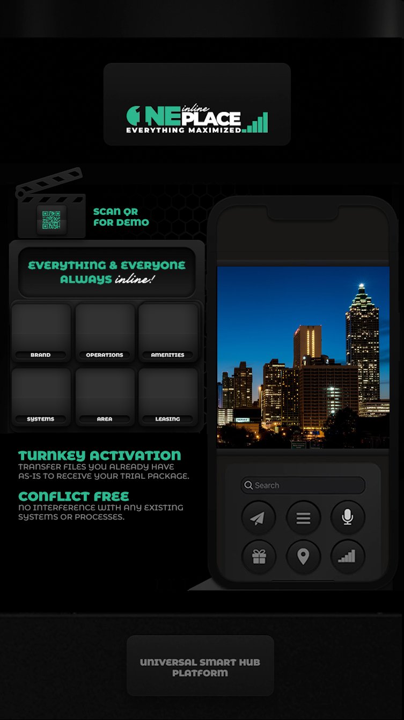

EVERYTHING MAXIMIZED
TURNKEY ACTIVATION
PAGE NO 03
YOU
Transfer files you already have as-is. It’s that easy! Install our demo app to register.
US
Once your files are transferred, everything is maximized by One Inline Place!
THEY
Mobile App evolves into your initial point of contact for nearly everything once it is installed!

